Slide 2
Key insight
Average score of 61.23% of the first report card for the 12th Assembly in 2011 and average score of 65.11% in 2016 the performance has increased.
Two MLAs [Amin Patel (84.33%) & Sunil Prabhu (80.97%)] have scored above 80%.
Score of top 20 percentile up from 71.14% in 2011 to 79.07% in 2016, while the laggards at the bottom remained more or less at the same level, from 52.82% in 2011 to 54.31% in 2016.
Quality of questions asked by the MLAs up from 49.63% in 2011 to 57.93% in 2016 and total number of questions asked has decreased from 7946 questions in 2011 to 4343 questions in 2016.
Score for Perceived Accessibility down from 66.05% in 2011 to 42.91% in 2016.
During the last (12th) assembly the average scores of the MLA’s showed a decline over the four report cards from 61.23% in 2011 to 59.17% in 2014. We would expect that the current group of MLAs defy the trend and increase their average performance from 65.11% in 2016 by the time we come up with the last report card for this term in 2019.

Slide 3
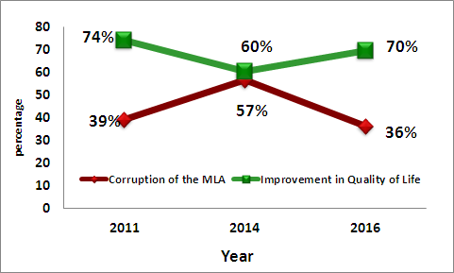
PERCEIVED CORRUPTION & ITS IMPACT ON QUALITY OF LIFE

Slide 4
The Constitution as a Basis for monitoring of Elected Representatives
ERs derive their powers for functioning through the Constitution
They are mandated to Attend Sessions, Raise people’s Issues, Debate, Participate in Discussions and Pass legislations.
The Constitution defines their powers and rules of functioning, hence only the Constitution can provide the parameters for their monitoring.

Slide 5
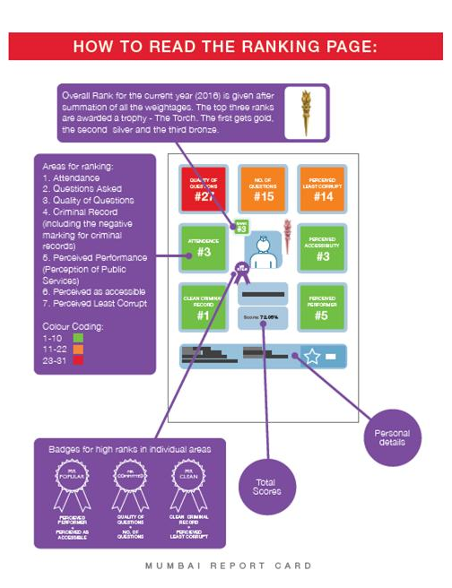

Slide 6
Parameters for Rating MLAs (1/4)
Parameter | Marks
Present¹(Attendance, No. & Quality of Questions, Usage of Area Development Fund) | 52
Past ²(Education qualification, PAN Card, Criminal cases) | 8
Perception (through an citizen survey of 25,215 people for their perception on their MLA’s accessibility/availability, performance, corruption, and satisfaction with quality of life, services provided by government) | 40
Negative for new FIR cases after 2014 election ³ | Minus 5
Negative for pending Charge Sheet ³ | Minus 5
Total | 100
RTI Data Source: ¹ Vidhan Bhavan and City & Suburban Collector Offices; ² Election Commission of India’s Website; ³ Mumbai Police.

Slide 7
Parameters for Rating MLAs (2/4)
Present Parameter (Marks)
Sessions Attended Based on percentage of attendance. 1) 100% to 91%- 10; 2) 90% to 76% - 8; 3) 75% to 61% -6; 4) 60% to 51% - 4; and 5) below 50% - 0 | 10
Number of Questions Asked Against Group Percentage Rank. 16 being the top most percentile and so on to the lowest for 1 | 16
Importance of questions asked Weightage is given to issues raised through the questions depending on whether they belong to the State List, Central List or are in the domain of Municipal Authority. In the aggregate scale (out of 100) the following weightage is given: Constituency (including City) gets 5; State gets 15; and National gets 1 | 21
Total Local Area Development Funds Utilised during Oct’2014 to March'2016 Calculation for the current financial year is done for the sanctioned fund of Rs. 2.50 crore.1) 100% (or more) to 91%- 5; 2) 90% to 76% - 4; 3) 75% to 61% -3; 4) 60% to 51% - 2; and 5) below 50% - 0 | 5

Slide 8
Parameters for Rating MLAs (3/4)
Past Parameter (Marks)
Education Qualification A minimum of 10th Pass - 1; if not – 0 | 1
Income Tax !) Possessing PAN Card - 1 2) Filling of last years IT returns – 1 | 2
Criminal Record If the candidate has zero cases registered against her/him, then 5; else as below: 1) Criminal Cases Registered containing the following charges: Murder, Rape, Molestation, Riot, Extortion - 0 2) Other criminal cases than the above mentioned – 3 | 5

Slide 9
Parameters for Rating MLAs (4/4)
Perception Parameter (Marks)
Perception of Public Services Score on Public Services | 20
Awareness & Accessibility Score on Awareness amongst people about their representative, their political party and ease of access to the representative | 6
Corruption Index Score on perceived personal corruption of the representative | 10
Broad Measures Score on overall satisfaction and improvement in quality of life | 4
Notes:
!) The weightage for Perception of Public Services was further divided into a hierarchy of 4 levels to meet the desired objective. Level 1 included facilities which are more critical to state government whereas Level 4 included facilities that are more critical to central government.
Level 1 – This level included areas like Power supply, Law & Order situation & Instances of crime. It was given a weightage of 8 points
Level 2 – This level included areas like Availability of food through ration shops & Pollution problems. It was given a weightage of 5 points
Level 3 – This level included areas like Hospitals & other Medical facilities & Appropriate Schools & Colleges. It was given a weightage of 4 points
Level 4 – This level included rest of the areas like Condition of Roads, Traffic Jams & Congestion, Availability of public gardens, Availability of public transport facilities, Water Supply, Water logging problems & Cleanliness & Sanitation facilities. It was given a weightage of 3 points
2) Broad Overall Measures: included opinions on Satisfaction with the MLA and Improvement in Lifestyle.

Slide 10
Party | MLAs Name | Score | Rank
INC | Amin Amir Ali Patel | 84.33 | 1
SS | Sunil Waman Prabhu | 80.97 | 2
INC | Varsha Eknath Gaikwad | 79.40 | 3
BJP | Yogesh Sagar | 78.35 | 4
INC | Aslam Ramazan Ali Shaikh | 75.76 | 5
SS | Sunil Govind Shinde | 75.63 | 6
INC | Kalidas Nilkanth Kolambkar | 72.54 | 7
INC | Md. Arif (Naseem) Lalan Khan | 72.13 | 8
BJP | Sardar Tara Singh | 68.81 | 9
SS | Ajay Vinayak Choudhari | 68.80 | 10
BJP | Atul Bhatkhalkar | 67.98 | 11
BJP | Ashish Babaji Shelar | 67.40 | 12
BJP | Mangal Prabhat Lodha | 67.13 | 13
SS | Sadanand Shankar Sarvankar | 66.38 | 14
SS | Prakash Vaikunt Phaterpekar | 65.88 | 15
BJP | Manisha Ashok Chaudhary | 65.71 | 16
SP | Abu Asim Azmi | 63.04 | 17
SS | Ashok Dharmaraj Patil | 60.85 | 18
BJP | Bharati Hemant Lavekar | 60.14 | 19
SS | Tukaram Ramkrishna Kate | 59.70 | 20
BJP | Ameet Bhaskar Satam | 59.27 | 21
BJP | Raj Purohit | 58.60 | 22
SS | Sanjay Govind Potnis | 58.37 | 23
SS | Sunil Rajaram Raut | 57.77 | 24
AIMIM | Waris Yusuf Pathan | 57.71 | 25
BJP | Selvan R. Tamil | 57.21 | 26
SS | Prakash Rajaram Surve | 56.25 | 27
BJP | Parag Madhusudan Alavani | 54.51 | 28
SS | Ramesh Kondiram Latke | 54.39 | 29
SS | Mangesh Anant Kudalkar | 53.96 | 30
BJP | Ramchandra Shivaji Kadam | 49.55 | 31

Slide 11
MLAs with criminal cases before elections
45% MLAs have criminal cases.
14 MLAs out of 31 have criminal cases (FIRs) registered against them and of the 14 MLAs, 12 have charge sheets filed against them before elections as per their election affidavits.
Notes:
Ideology and No Social Service

Slide 18
THANK YOU!!!

